Slide 1

Chat with Your PDF
DeepSeek 7B Powered Intelligent PDF Q&A System
SYED ABDALLAH ALBEEZ
SYeD7862001@gmail.com
MST02-0082

Slide 2
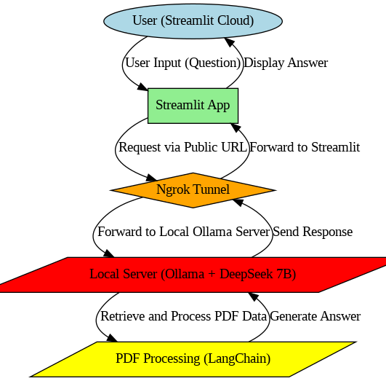
Introduction
The project enables users to chat with PDFs by asking questions and receiving AI-generated responses.
Uses Ollama's DeepSeek 7B for NLP and LangChain for document processing.
Hosted on Streamlit Cloud with Ngrok tunneling to connect with a local Ollama server

Slide 3

Problem Statement
PDFs contain valuable information but are not easily searchable.
Manually searching for information in long documents is time-consuming.
Need for an AI-powered solution that enables efficient document interaction.

Slide 4
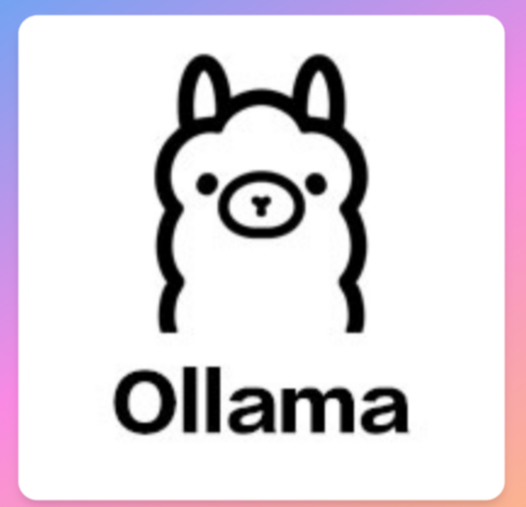
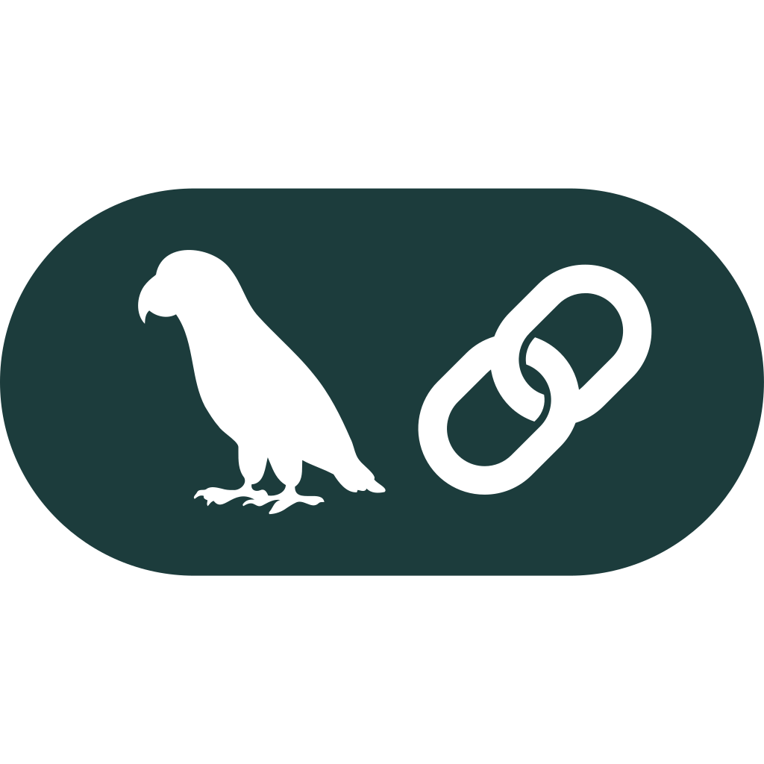


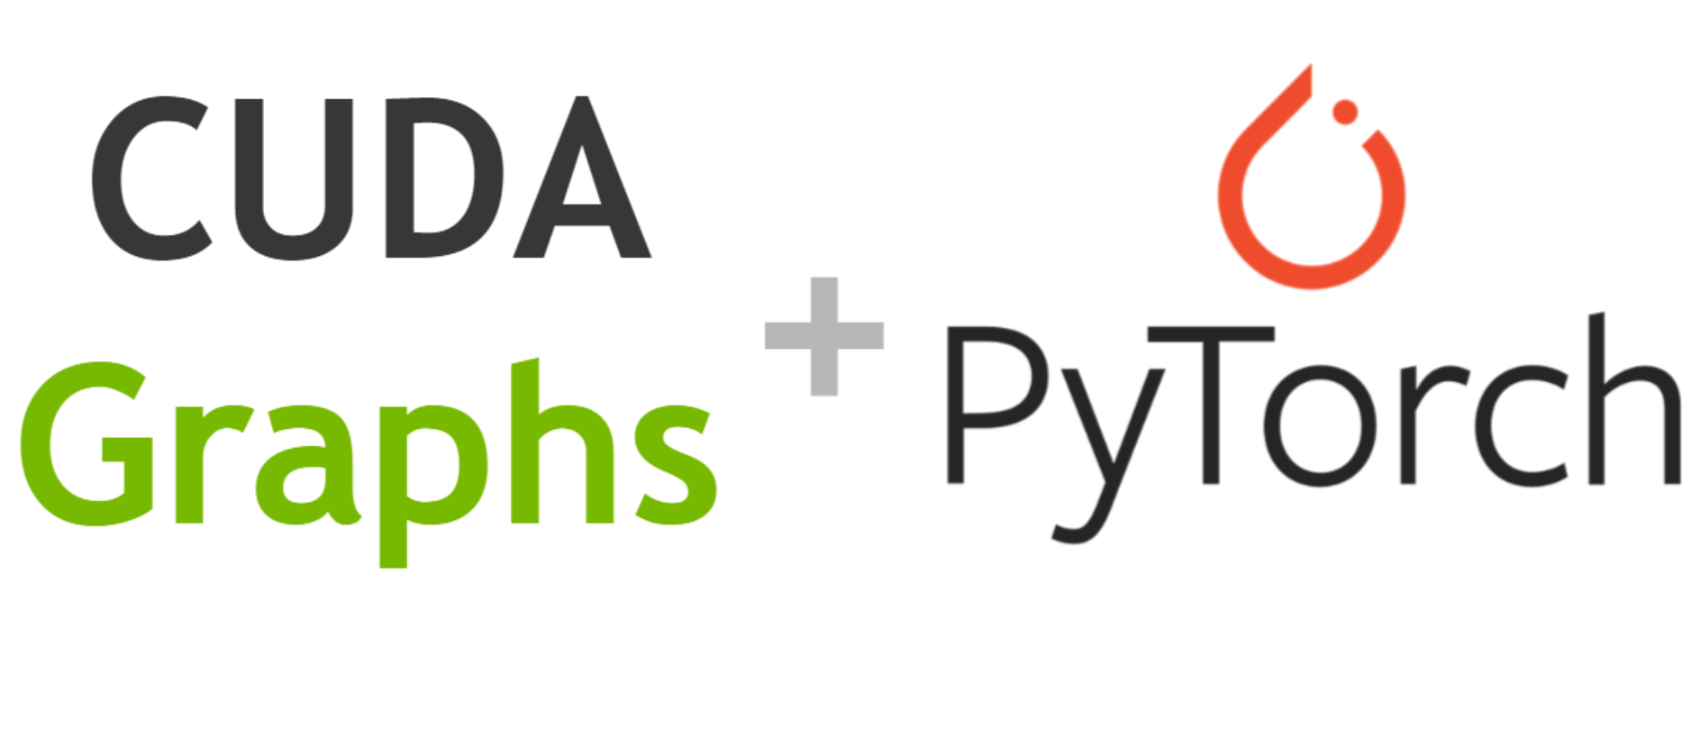
Technology stack
Ollama: Runs DeepSeek 7B for generating responses.
LangChain: Manages document retrieval and processing.
Streamlit: Provides an interactive cloud-based UI.
Ngrok: Exposes the local Ollama server to the cloud.
PyTorch & CUDA: Enables GPU acceleration for AI computations.

Slide 5
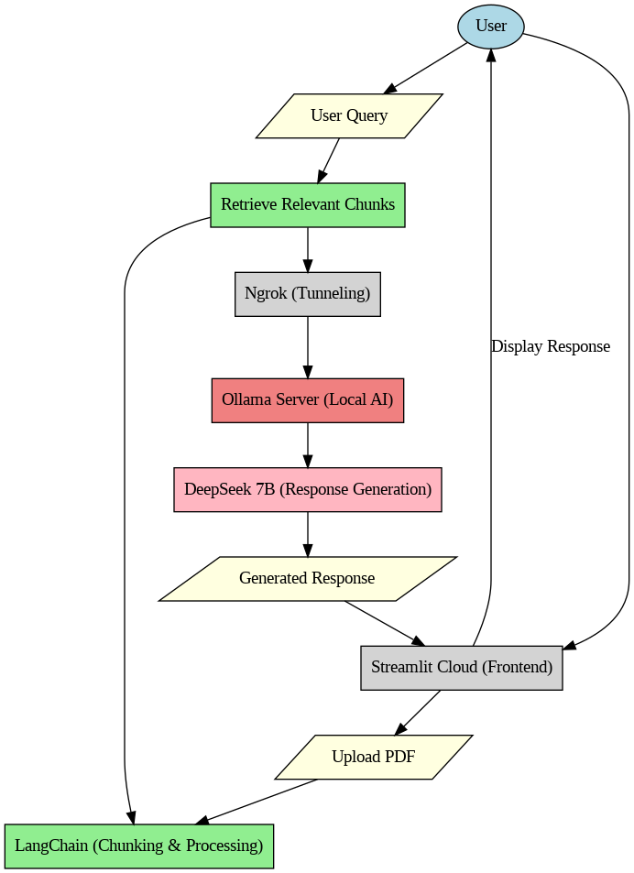
System Architecture
User uploads a PDF via Streamlit Cloud.
PDF is processed using LangChain and split into chunks.
User asks a question; relevant PDF chunks are retrieved.
The query is sent to the local Ollama server via Ngrok.
DeepSeek 7B generates a response, which is sent back to Streamlit.

Slide 6
Ngrok Tunnel Explanation
Streamlit Cloud cannot directly communicate with local servers.
Ngrok provides a secure public URL that tunnels requests to the local machine.
Ensures seamless communication between cloud and local resources.

Slide 7

DeepSeek 7b
What is DeepSeek 7B? – A powerful open-source large language model (LLM) optimized for natural language understanding and generation.
Why DeepSeek 7B? – It balances performance and efficiency, making it ideal for handling PDF-based queries.
How is it used? – It processes questions and generates relevant answers using context from the document.
Runs on Your Local Machine – The model is hosted locally and accessed via Ngrok to serve the

Slide 8

Implementation Details
PDF Handling: Extracts text using PDFPlumber.
Text Chunking: Splits content into manageable sections.
Vector Store: Uses embeddings to index and retrieve relevant content.
LLM Querying: Ollama processes the question and returns an AI-generated response.

Slide 9
Results & Benefits
Provides quick and accurate answers from PDF content.
Enhances accessibility of information in large documents.
Enables seamless cloud-to-local AI integration via Ngrok.
Future scope: Add multi-document support and fine-tune models for better accuracy.

Slide 10
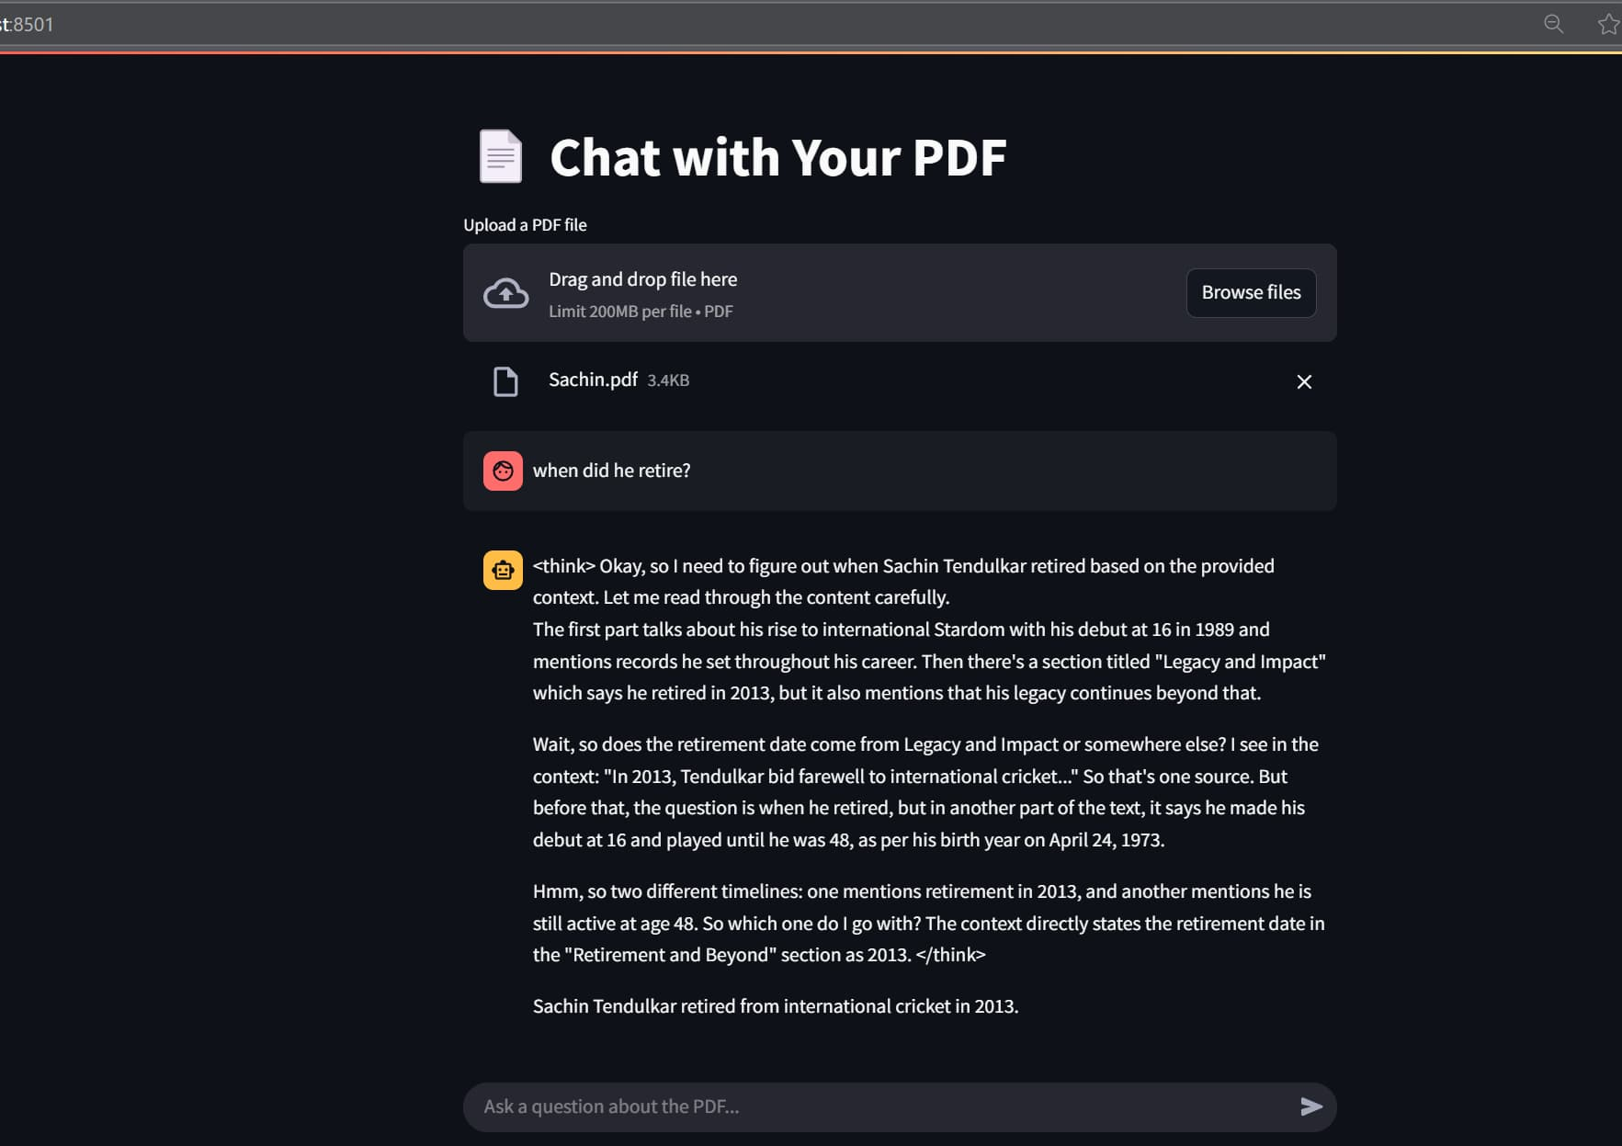
Output:
Streamlit

Slide 11
Conclusion
Successfully implemented an AI chatbot for PDF interaction.
Combined LangChain, DeepSeek 7B, and Streamlit for an efficient solution.
Ngrok enables secure cloud-to-local communication.
Can be extended with more powerful models and integrations.

Slide 12
THANK YOU!

